Slide 1
Lunch-and-Learn: Tracking the Body: Tools and Apps You Can Use
Texas State Employee Wellness Program
January 27, 2015
Janet Bezner, PT, DPT, PhD
Associate Professor
Department of Physical Therapy

Slide 2
Overview
What can be tracked?
Range of tracking devices and cost
Tracking apps
Why track?
How to select a tracking device
Tips for getting more movement in your life

Slide 3
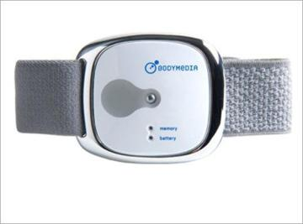
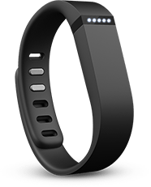
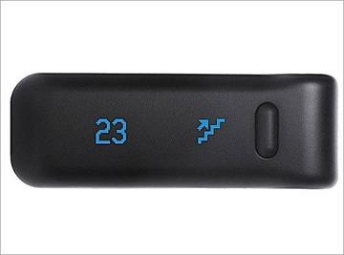
Fitness Tracking
Body Media Fit
Armband tracks caloric expenditure, activity levels, sleep patterns
$179 – $259.00.
FitBit
Variety of tracking devices from clip-ons to arm bands
Tracks physical activity, nutrition and sleep
$60.00 to $100.00
Notes:
There are over 100,000 devices on the market!
Can purchase FitBits through employee discount program from both Verizon and At&T

Slide 4
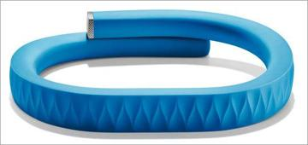
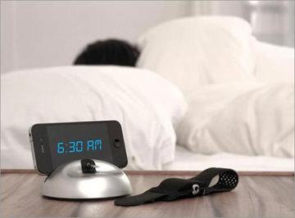
Fitness Tracking
Lark
Bluetooth enabled bracelet
Wakes you up by delivering pulsing vibrations on a pressure point on inner wrist
Tracks activity and gives personalized feedback
$69 - $129.00
Jawbone UP
Flexible wristband
Tracks exercise, diet, sleep
$100.00

Slide 5
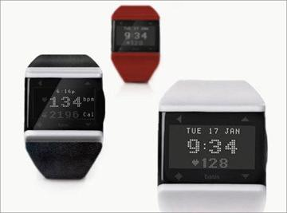
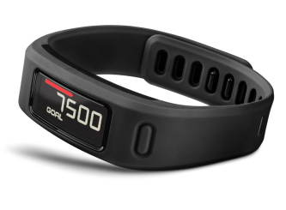
Fitness Tracking
Basis
Wrist-worn device measures HR, caloric burn, sleep patterns, cycling
$199.00
Garmin Vivofit
Wrist-worn activity tracker
Monitors steps, distance, sleep, calories burned
$98.00-$129.00
Notes:
Basis auto-detects running, walking, bicycling, and sleeping. Measures REM, light and deep sleep automatically. Focuses on habits rather than raw numbers. Doesn’t measure distance.
Most interesting activity tracker on market.

Slide 6
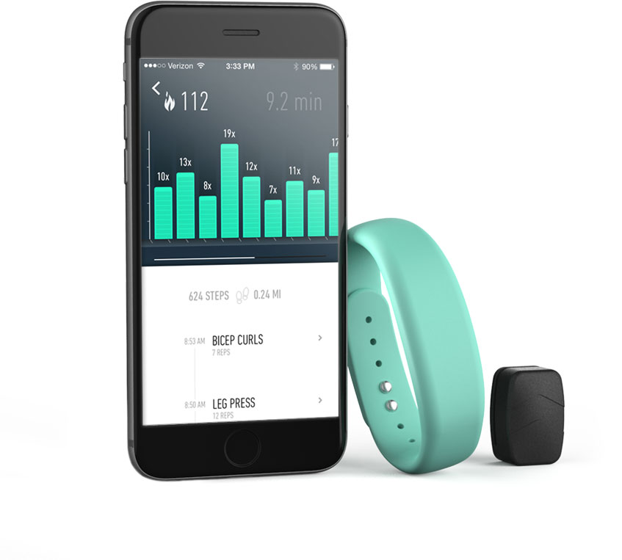
Fitness Tracking
Amiigo
Tracks swimming, cycling, health club activities
More advanced
Measures HR, blood pressure variation, blood oxygen saturation, respiratory rate
$179.00

Slide 7
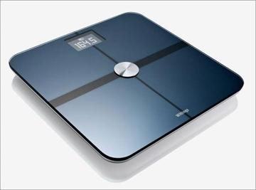
Weight
Withings Wi-Fi Body Scale
Sends body measurements to computer or iPhone to track gains and losses over time
$150.00

Slide 8
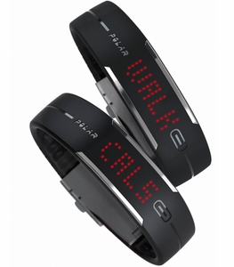
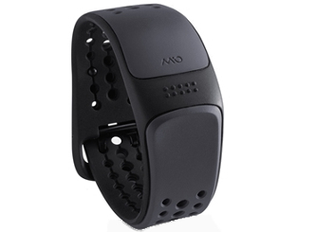
Heart Rate
MIO Link
Wrist-worn heart rate monitor
Works with many apps and devices
Water resistant
$99.00
Polar Loop Activity Monitor
Activity tracking, calorie counter, steps, heart rate, inactive time, sleep time
$90.00
Notes:
Garmin and Polar have many HR monitors that require a chest strap and a watch

Slide 9
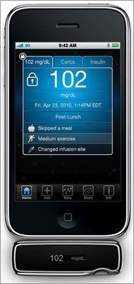
Diabetes
AgaMatrix
Mobile blood glucose tracker
Plugs into iPhone and tracks blood sugar, carbohydrate intake, insulin

Slide 10
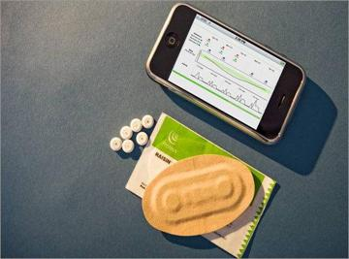
Medication Adherence
Proteus “Smart Pills”
Microchipped medication tablets that track patient adherence with a smartphone app
Can also detect information about the body’s response to the medicine

Slide 11
Fitness & Wellness Apps
Fitocracy (Android and iOS) FREE
Earn points, badges and use social pressure to compete with others
Plans workouts, tracks workouts
Ideal for gym rats
Hot5Fitness (iOS) FREE
50 minutes of videos of men and women in a variety of programs (yoga, flexibility, abs, core, cardio, muscle strengthening)
Follow pre-set workouts or build your own
Syncs with MyFitnessPal to access calories consumed
Johnson & Johnson Official 7 minute workout
7-minute workout using body weight, chair, wall
Includes video tutorials and a timer
https://7minuteworkout.jnj.com/
Notes:
http://www.cio.com/article/2369248/healthcare/138681-12-Top-Fitness-and-Wellness-Apps-for-2014.html

Slide 12
Fitness & Wellness Apps
Moves (Android FREE, iOS $3.00)
Tracks walking, cycling, running using smartphone sensors/GPS
App runs continually in background tracking activity and estimating calories burned
MyFitnessPal (Android & iOS) FREE
Physical activity and nutrition tracking
Extensive database of foods (you enter ingredients and you get calories, etc.)
Syncs with other trackers and apps (any fitness app or tracker) and adjusts daily calorie allotment based on calories burned during activity tracked
RunKeeper (Android & iOS) FREE
Activity tracker and creates workouts based on goals (get fit, lose weight)
Syncs with numerous heart rate monitors
Can create customized workouts, includes audio feedback while exercising

Slide 13
Fitness & Wellness Apps
Zombies, Run! (Android & iOS) $3.00
Part “zombie apocalypse” game, part fitness app, part health app
You play the hero in the story
Can share workouts with friends and track activity and achievement

Slide 14
Fitness & Wellness Apps
Fooducate (Android and iOS) FREE
Educates about the food you eat
Barcode scanner
Provides options/replacements
Tracks food eaten
Most of the useful features require a premium plan that’s $5.00 for 3 months or $15.00 for one year
HealthyOut (Android and iOS) FREE
Guide to local restaurant dishes
Can search for restaurants based on diet or dietary needs/preferences
Weight Watchers Simple Start
2 weeks of meals to jumpstart weight loss
Tracks meals also
Need a Weight Watchers eTools account or a subscription to use the app

Slide 15
Fitness & Wellness Apps
TempoRun (iOS) $3.00
Plays DJ for your workout by scanning your music library and categorizing tracks from 1 to 10 in terms of workout intensity
Can also manually assign levels to your songs
Tracks miles covered, calories burned, pace
Sickweather (iOS) FREE
Tracks illnesses and infectious diseases in your area (flu, bronchitis, chicken pox, norovirus, etc.)
Can opt to receive alerts

Slide 16
How accurate and useful are these devices?
Accuracy
Based on a systematic review published in February 2014 of 26 articles and a small research study published in January 2015
Most devices and apps are pretty accurate
Small differences among devices – some over count and others under count
Usefulness
Provide real time feedback
Social networking
Expert consultation
Goal setting
Notes:
Bort-Roig J, Gilson ND, Puig-Ribera A, Contreras RS, Trost SG. Measuring and influencing physical activity with smartphone technology: a systematic review. Sports Med. 2014;44:671-686.
Case MA, Burwick HA, Volpp KG, Patel MS. Accuracy of smartphone applications and wearable devices for tracking physical activity data. Research Letter. JAMA. 2015;313(6):625-626.

Slide 17
Why Track?
Build awareness
To learn more about your current habits
Change starts with awareness of what you are currently doing
Create a baseline
Develop a program to progress/build/change
Measure progress
Build in rewards
Motivation
Doesn’t work for everyone, but documenting progress can be a HUGE motivator for many!
Determine if a health treatment plan is working
For example, managing weight, blood pressure, cholesterol, etc.
Notes:
Evidence suggests that people who want to change their health habits should regularly monitor their progress

Slide 18
How to Select a Tracking Device
Almost all are between $100-$200.00
Almost all have a major flaw (there is no ‘perfect’ device!)
Start with a free app to see how you like it
Moves
Argus
iPhone Health
Bracelet, Watch or Clip-on?
Bracelets and watches are hard to lose (Basis, Jawbone) but can get in the way while you are working and are not always eye-catching accessories
Clip on devices are smaller and can be worn discretely
Easier to lose or send to the cleaners or washing machine
Not practical for those who wear dresses
Notes:
http://www.pcmag.com/article2/0,2817,2458147,00.asp

Slide 19
How to Select a Tracking Device (cont.)
Step counting or more?
Many of the devices track steps, so useful if you run or walk
Need a more sophisticated device to track other activities (bicycle, swim, sports) that is more expensive (sports watch (Garmin Vivofit))
Need heart rate monitoring?
Need sleep data?
Useful only if you have trouble sleeping
Desire to track data long term
Use a product that syncs with an app because most of the devices don’t track over time

Slide 20
Bottom Line
Tracking devices and apps are very useful and provide fairly reliable information about YOU
Easy to use and learn to use
$100-200 investment for a tracking device
Not for everyone
Can be very motivating and a nice adjunct to forming healthy habits
Sit less….how?

Slide 21
10 Steps to Move More
Wear a tracking device
Track your sitting time with a stop watch or app
Set a timer for a get-up break each 30 minutes
Use an exercise ball as a chair
Pace or stand up while talking on the phone
Don’t make things too convenient
Get a treadmill desk or deskcycle
Take meetings outside your office – walking meetings
Get up and go talk to someone rather than emailing or messaging
Find ways to add walking before or after a long commute

