Slide 1
Lunch ‘N’ Learn: Meal Planning
Sylvia Crixell, PhD
Catherine Applegate, BS

Slide 2
Today’s discussion
Healthy Dieting
Grocery Shopping
Meal Planning Services
Cooking in Advance
Adding Variety

Slide 3
Meal planning is an individualized process
There is no “one size fits all” plan
South Beach Diet – Phase 1 = lose 10 pounds in 14 days
Dr. Oz’s Two-Week Rapid Weight Loss Plan

Slide 4
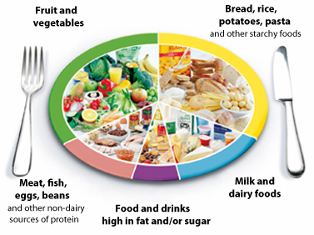
A healthy diet includes all food groups
Whole grains
Fruits, vegetables
Limit saturated and trans fats
Limit sodium and added sugar
Low-fat or fat-free dairy
Lean meats, poultry, fish, beans, eggs, nuts
Notes:
https://www.nhlbi.nih.gov/health/educational/lose_wt/eat/calories.htm

Slide 5
Losing weight healthily
Lose 1-1 ½ lbs/week by reducing daily intake by 500-750 kcal
1,500-1,800 kcal/day for men
1,200-1,500 kcal/day for women
Very low calorie diets of fewer than 800 calories per day should be avoided.

Slide 6
Don’t Go Hungry
Physical Activity
Calorie Intake
Notes:
http://www.cdc.gov/healthyweight/healthy_eating/energy_density.html -- You can cut calories without eating less nutritious food. The key is to eat foods that will fill you up without eating a large amount of calories.

Slide 7
Plan for Food
Eat smaller portions more frequently
Make a grocery list
No idea what to add?
www.letsmove.gov
Notes:
http://www.letsmove.gov/sites/letsmove.gov/files/Grocery_List.pdf

Slide 8
meal planning delivery services

Slide 9
500-700 calorie meals pre-measured for the included recipe
2-person plan, 3 meals/week for $60
Family of 4 plan, 4 meals/week for $140
Notes:
Recipes never repeated in the same year. Fresh ingredients.

Slide 10
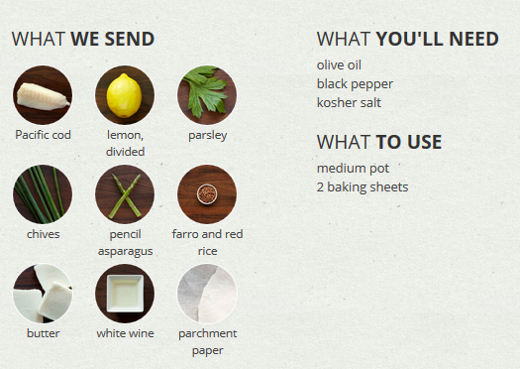
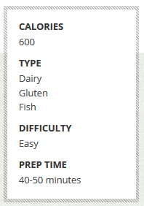
Order ingredients for 2, 4, or 6 plates starting at $12/plate

Slide 11
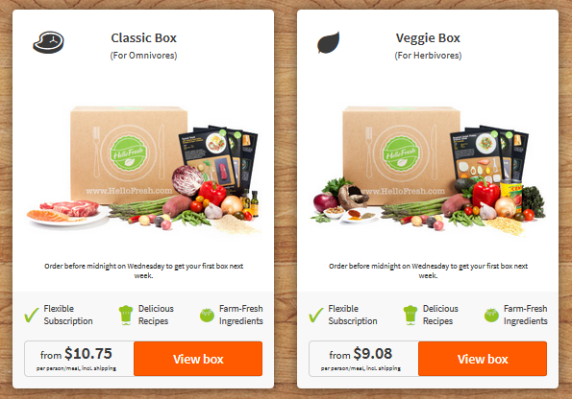

Slide 12
Local Services
Special diet entrées ranging from $13-14 + tax + $17 for shipping

Slide 13
Online meal planning

Slide 14
Receive new menus every week. Select your favorite recipes and add to your grocery list. Scale your recipes, edit your grocery list, print, and shop!
$5-7 per month

Slide 15
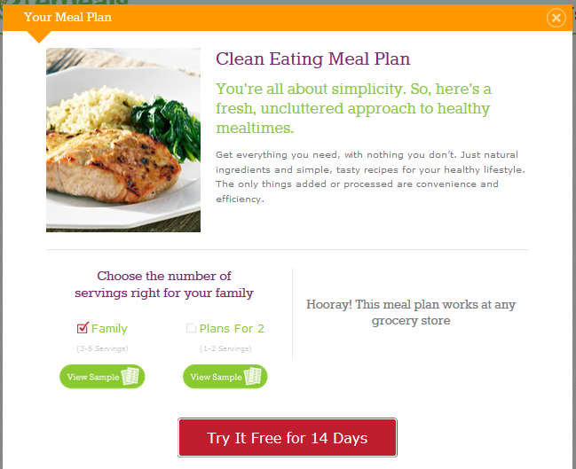
Pick your plan
Get recipes
Shop
Cook
$5-10/month

Slide 16
$5.42-10/month

Slide 17
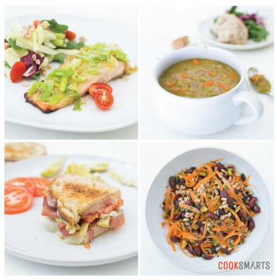
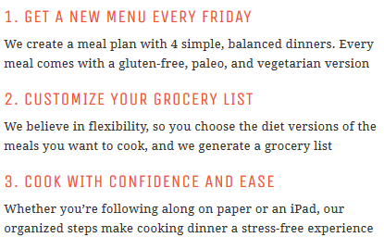
$6-8/month

Slide 18
Meal planning and recipe apps

Slide 19
Available FREE on iPhone, iPad, Android phones, tablets, Kindle Fire, and NOOK devices
Import recipes from online or add manually
Cook Mode assists the cook in the kitchen
Add recipes to calendar to plan weekly meals
Create shopping lists automatically by planning weekly recipes

Slide 20
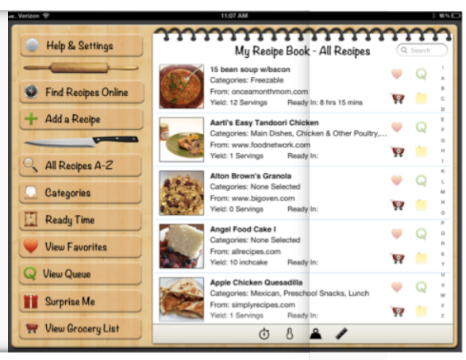
Available for $0.99 on iPhone and iPad.

Slide 21
Available for $4.99 on iPhone, iPad, Android phones, tablets, Kindle Fire, NOOK devices, Mac, and Windows computers

Slide 22
Cooking in advance
Make a pot of beans over the weekend
Cooked meat stays fresh for 4 days in the fridge
Make your own “frozen dinner”
Cook extra brown rice for other recipes
Marinate for days in advance

Slide 23
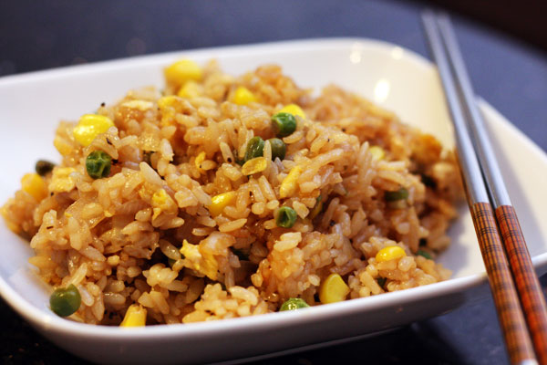
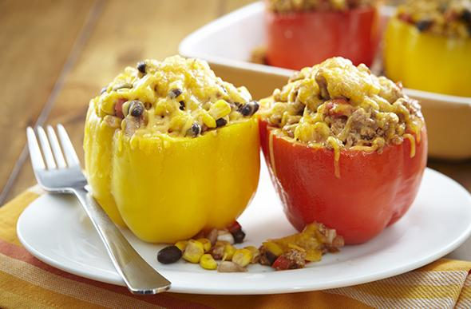
1-2 day old brown rice
Fried Rice
Scrambled eggs
Diced chicken
Mixed vegetables
Ginger, garlic, sesame seeds, low-sodium soy sauce or Bragg’s Liquid Aminos, teriyaki sauce, olive oil
Stuffed Bell Peppers
Cooked ground beef, turkey, diced chicken, or beans
Slivered almonds
Cheddar cheese
Garlic, onion, Worcestershire sauce, tomato paste, chili flakes

Slide 24
Marinades
Sherry or wine vinegar
Low-sodium soy sauce
Ginger, garlic
Soyaki or teriyaki
Brine:
Water, sugar, salt, fresh herbs, lemon, orange, onion, garlic, celery, carrots
Lemon and wine

Slide 25
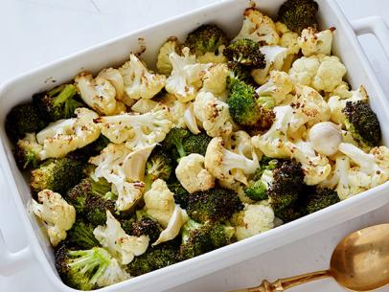
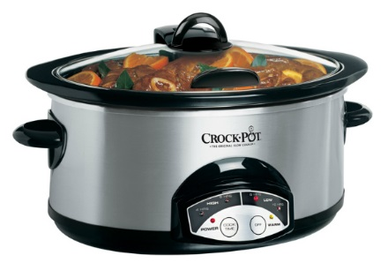
Quick Cooking
Slow cooking
Crock pot or Dutch oven
Roasting
Oven roast vegetables
Meats, soups, chili, vegetables
Break up cauliflower and broccoli and add whole cloves garlic; after 35 minutes, squeeze lemon and roast 10 more minutes
Chicken and tomatillo sauce; after 2 hours, add shredded carrots and white beans for 1 more hour

Slide 26
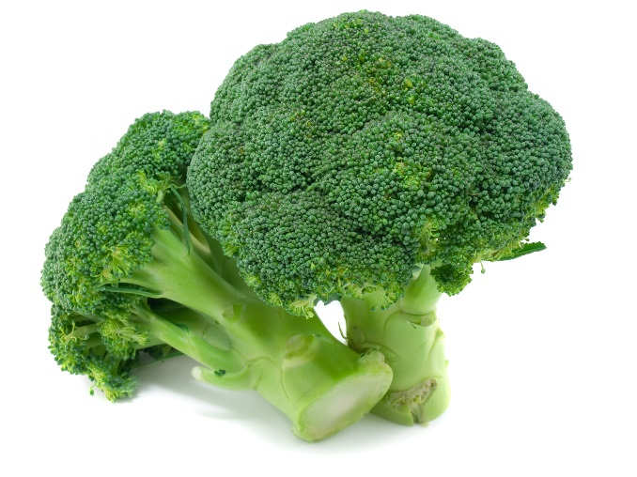
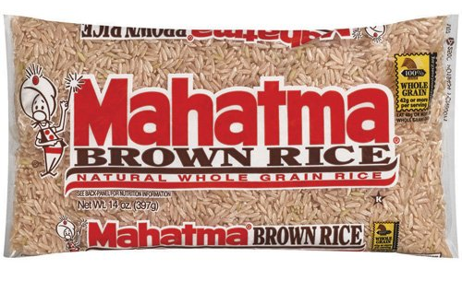
Budgeting is easy
$1.70 per pound
$2-4 per pound
$2.97 per pound

Slide 27
Picky eaters?
Hide vegetables in pureed sauces
Kale or broccoli in pesto
Bell pepper in tomato sauce
Make food colorful
Add strawberries to spinach salad
Make dressings

Slide 28
Flavor variation
Produce
Match texture with zucchini and mushrooms or broccoli with cauliflower
Season with lemon, garlic, and fresh thyme and rosemary
Grains
Experiment with quinoa, barley, or different rice varieties
Cook in broths to add flavor
Meats
Vary cooking methods such as roasting, grilling, baking, or sautéing
Season with rubs or marinades
Notes:
Add an entire half lemon or orange, or the entire twig of a fresh herb

Slide 29
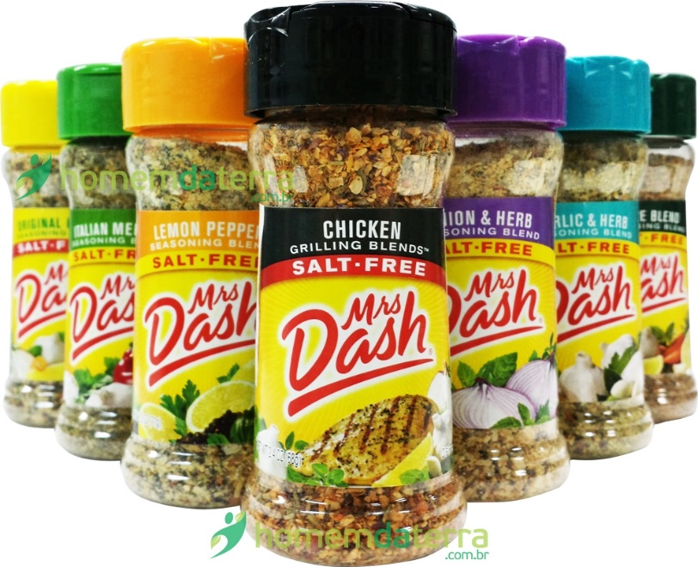
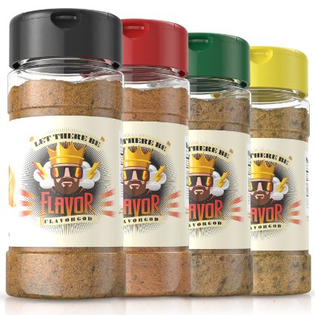
Try different seasonings
Salt-free and flavorful
Freshly ground and made-to-order, low-sodium, and flavorful

